Slide 1
MULTIPLE DISEASE PREDICTION USING MACHINE LEARNING
PRESENTED BY :
NEHA ZULFIQAR KHUNDMIRI
1DS21MC059

Slide 2
INTRODUCTION
This application introduces a novel approach in healthcare machine learning by offering a unified system for predicting multiple diseases via a single user interface.
The model covers critical illnesses like diabetes, heart disease, chronic kidney disease, and cancer, with the potential to save lives through early detection.
The system employs diverse classification algorithms including K-Nearest Neighbor, Support Vector Machine, Decision Tree, Random Forest, Logistic Regression, and Gaussian naive bayes, ensuring accurate predictions.
Rigorous validation and comparison of each algorithm determine the optimal choice.
Multiple datasets, one for each disease, contribute to achieving the highest prediction accuracy, ultimately resulting in a comprehensive web application for multi-disease forecasting powered by machine learning.

Slide 3
PROJECT DESCRIPTION
The Multi-Disease Predictor project employs advanced machine learning to predict multiple diseases using diverse medical data sources, fostering early detection and personalized patient care.
Disease-specific models are developed through a combination of supervised and unsupervised learning, offering transparent insights into prediction factors.
Real-time predictions empower healthcare practitioners to intervene promptly, enhancing patient outcomes.
The system's scalability and adherence to data protection regulations enable easy integration and safeguard patient privacy.
This collaborative initiative aims to revolutionize healthcare through proactive, data-driven practices.

Slide 4
TOOLS AND TECHNOLOGIES
HTML
CSS
BOOTSTRAP
Bootstrap is a free and open-source CSS framework designed for front-end web development that prioritizes mobile responsiveness. It includes design templates for typography, forms, buttons, navigation, and other interface elements in HTML, CSS, and (optionally) JavaScript.
The preferred markup language for documents intended to be viewed in a web browser is HTML, or HyperText Markup Language. It describes the purpose and organization of web content.
CSS is a style sheet language that is used to describe how a page that has been produced in a markup language, such as HTML or XML (including XML dialects like SVG, MathML, or XHTML), will look.

Slide 5
TOOLS AND TECHNOLOGIES
PYTHON
LIBRARIES
MODELS
Scikit-learn: A powerful machine learning library for building predictive models.
TensorFlow : Deep learning frameworks for creating complex neural network models.
Pandas and NumPy: Data manipulation and numerical computation libraries.
A high-level, all-purpose programming language is Python. Code readability is prioritized in its design philosophy, which makes heavy use of indentation. Python uses garbage collection and has dynamic typing.It supports a variety of programming paradigms, including procedural, object-oriented, and functional structured programming
Gaussian naive bayes,
Decision Tree,
Random Forest,
Logistic Regression
Support Vector Machine

Slide 6
FUNCTIONAL REQUIREMENTS
Multi-Disease Prediction: The application should be capable of predicting multiple diseases such as diabetes, heart disease, chronic kidney disease, and cancer based on input data.
User Interface: The system should offer a user-friendly interface where healthcare practitioners can input patient information and receive disease predictions.
Algorithm Integration: The application must implement various classification algorithms (K-Nearest Neighbor, Support Vector Machine, Decision Tree, Random Forest, Logistic Regression, Gaussian naive bayes) to perform disease prediction.
Accuracy Validation: The accuracy of each algorithm should be validated and compared with each other to identify the most accurate algorithm for disease prediction.
Dataset Utilization: Multiple datasets, each specific to a disease, should be utilized to enhance prediction accuracy for different diseases.
Real-time Predictions: The system should provide real-time predictions, enabling prompt interventions and timely patient care.
Scalability: The application's architecture should be scalable, allowing for easy integration of new diseases and data sources in the future.

Slide 7
NON FUNCTIONAL REQUIREMENTS
Performance: The application should deliver predictions within a reasonable response time, even with a large volume of concurrent users.
Accuracy: The prediction accuracy of the chosen algorithm should be high to ensure reliable disease forecasts.
Usability: The user interface should be intuitive and easy to navigate for healthcare practitioners with varying levels of technical expertise.
Security: The application must adhere to rigorous data protection regulations (such as HIPAA) to ensure patient data privacy and security.
Reliability: The system should be highly reliable, minimizing downtime and ensuring consistent availability for healthcare practitioners.
Compatibility: The application should be compatible with various devices and browsers commonly used in healthcare settings.
Scalability: The system should be able to handle increasing data volume and user traffic as the number of users and diseases grows.

Slide 8
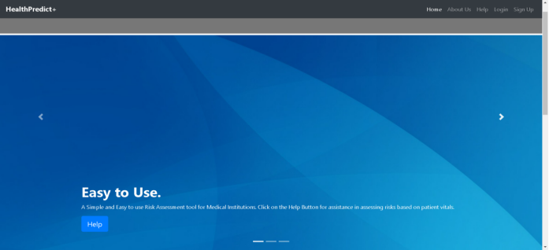
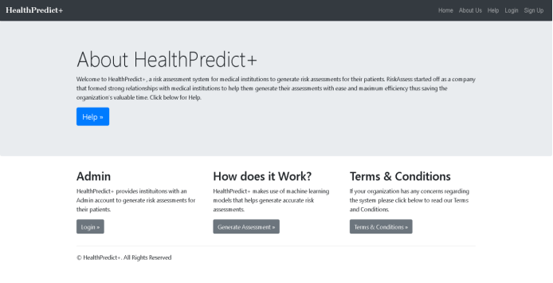
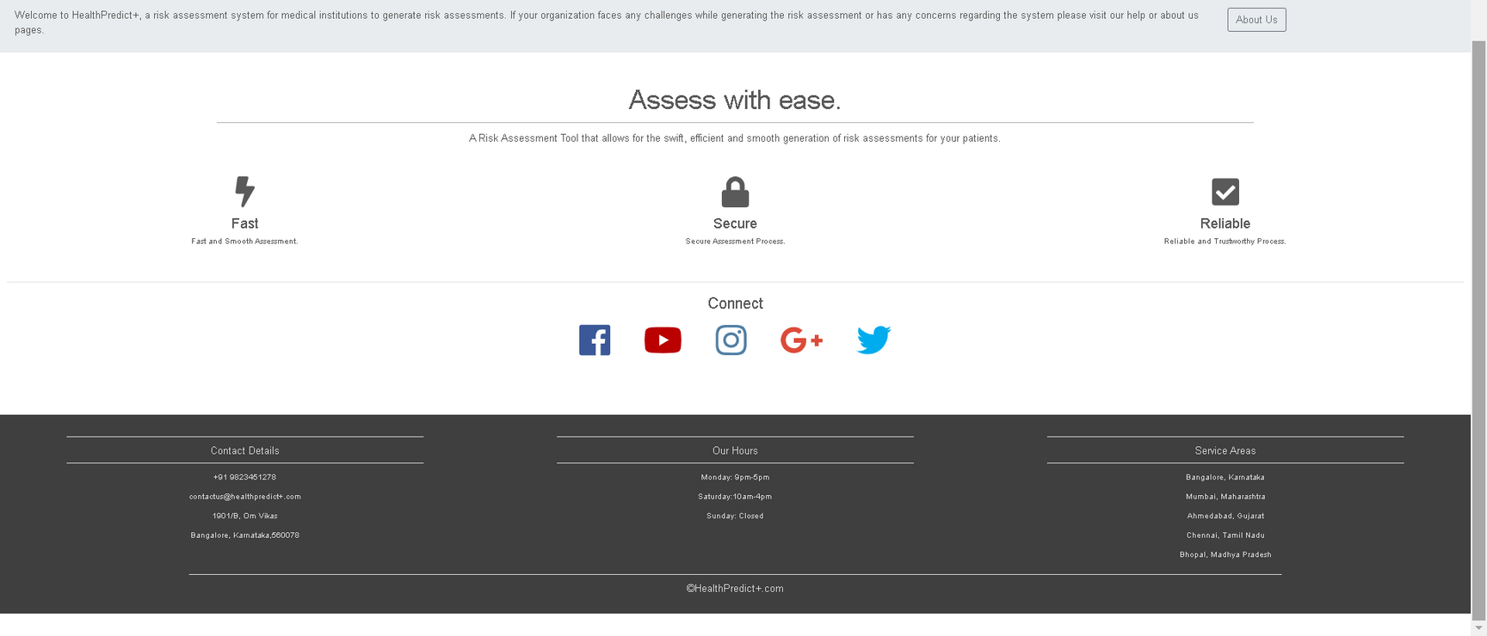
SNAPSHOTS

Slide 9
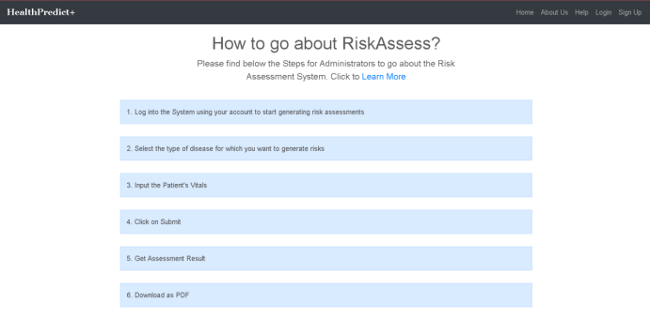
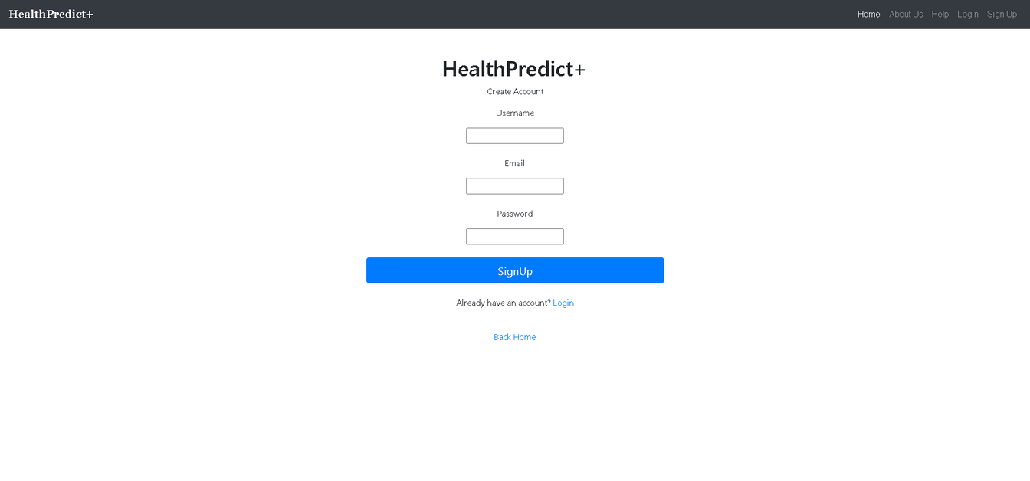
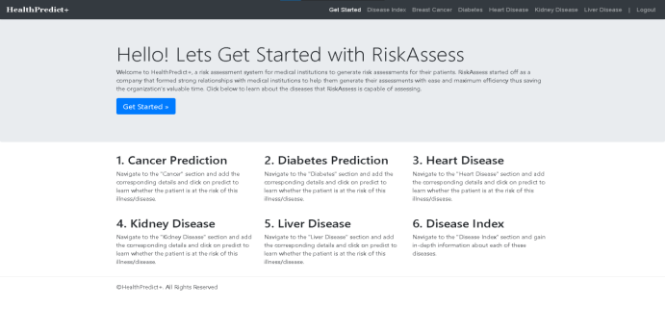
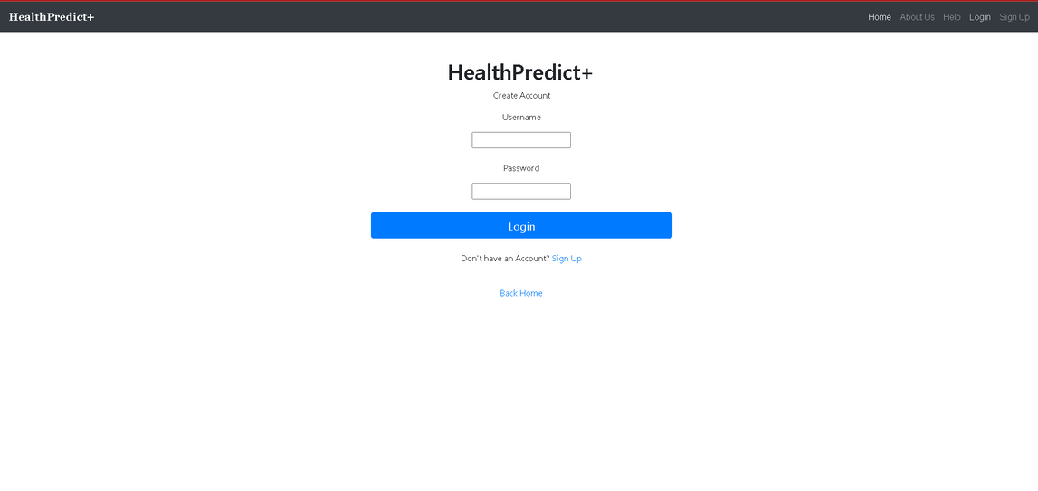
reallyygreatsite.com

Slide 10
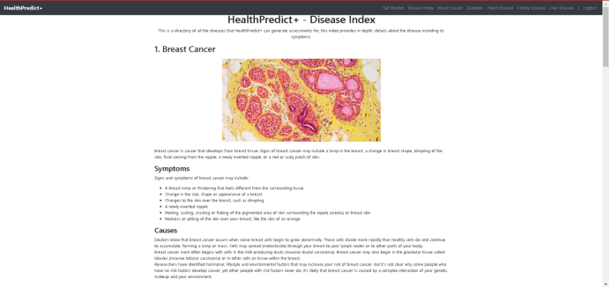
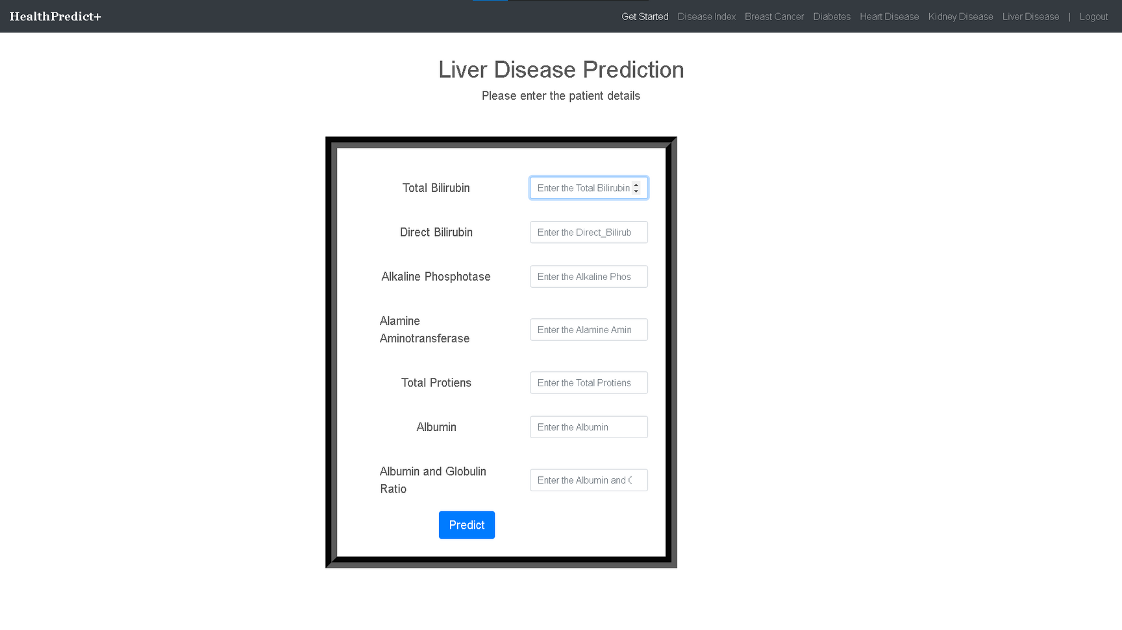
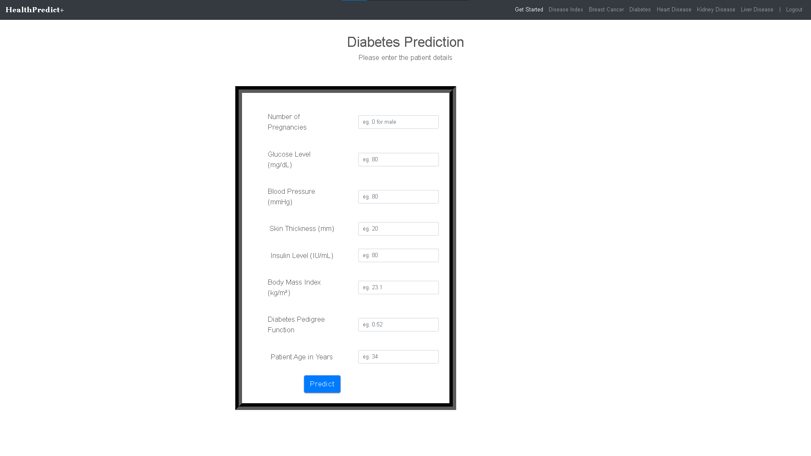
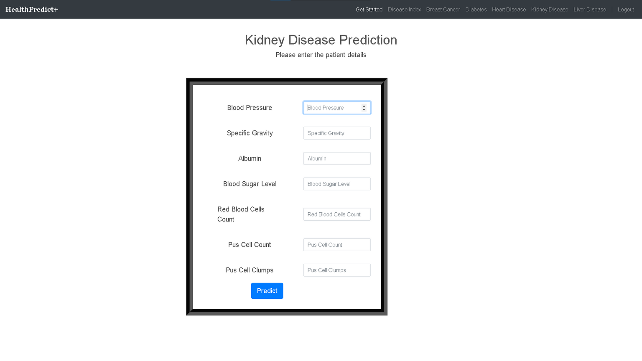
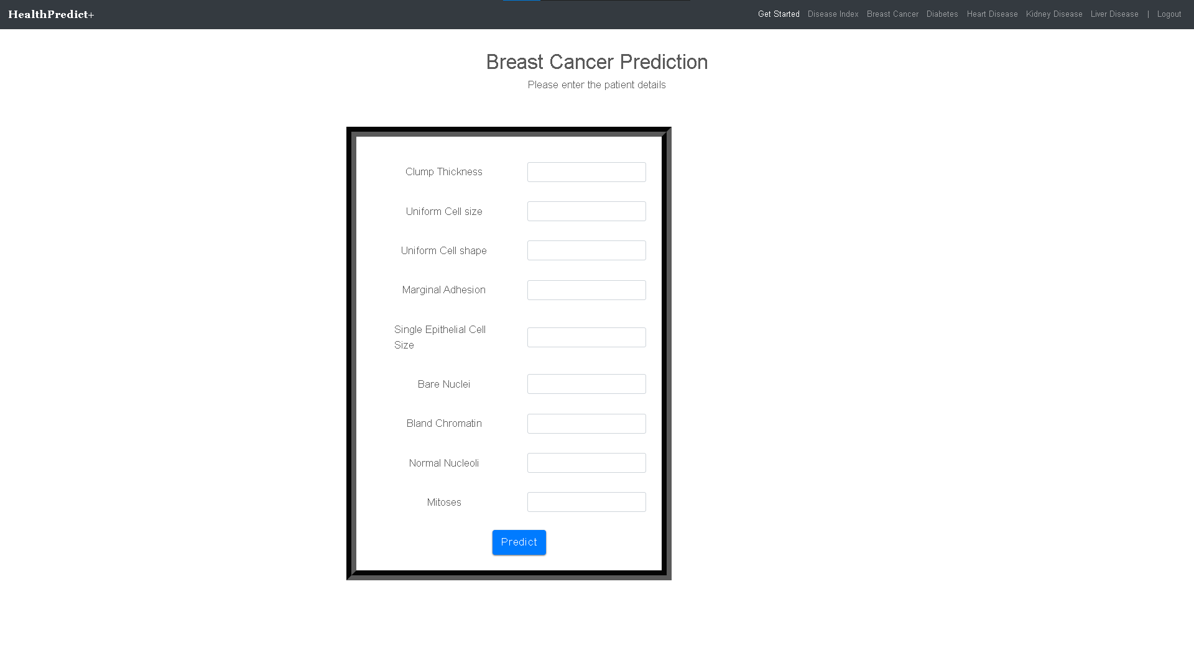

Slide 11
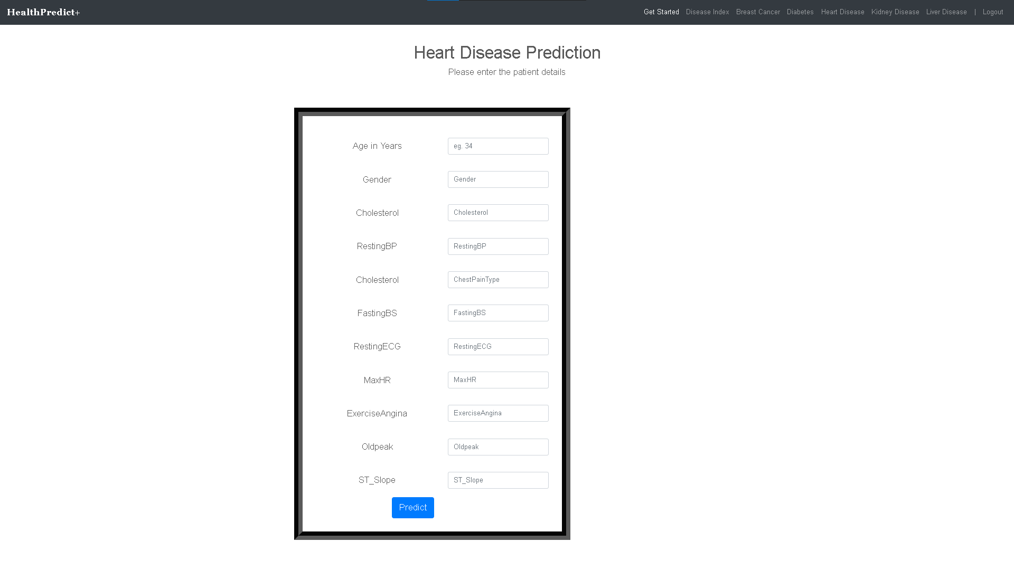
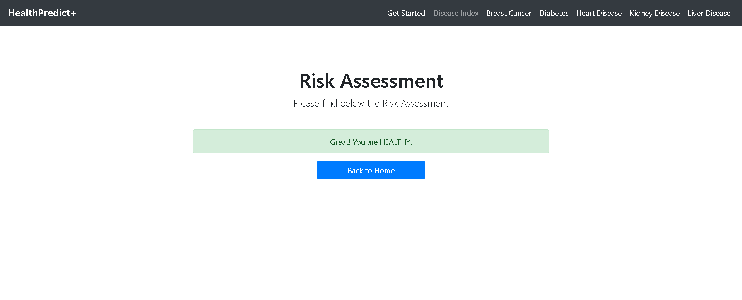
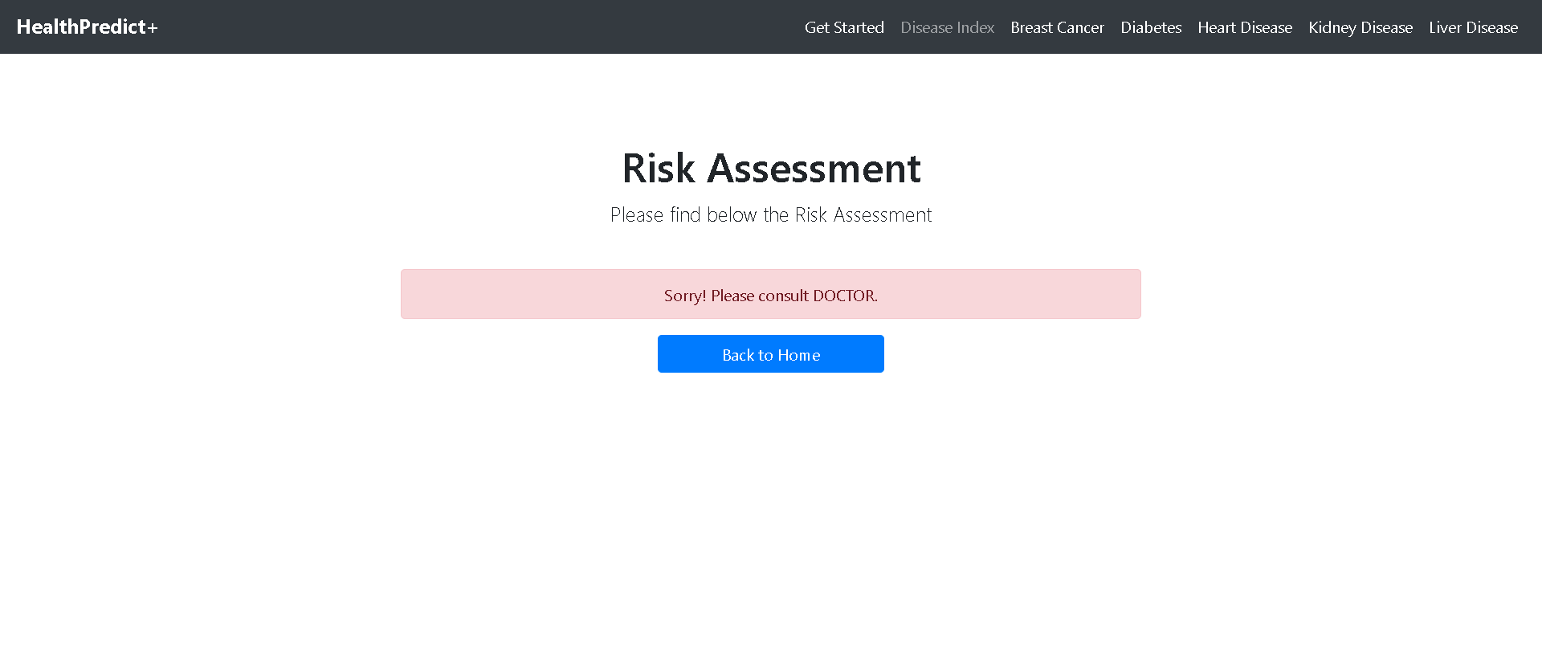

Slide 12
CONCLUSION
The multi-disease prediction web application offers a transformative approach to healthcare by utilizing data analysis and machine learning.
Users can gauge their disease risks using personalized data through an intuitive interface, promoting proactive health management.
The application's strength lies in early disease detection, vital for effective intervention and prevention.
Its adaptable nature allows for incorporation of the latest medical insights, ensuring sustained accuracy.
This collaborative blend of technology and medicine signifies a significant step towards a healthier society through informed healthcare decisions.

Slide 13
FUTURE ENHANCEMENT
The multi-disease prediction web application leverages data analysis and machine learning to revolutionize healthcare
Its user-friendly interface enables personalized risk assessment, fostering proactive health management.
The emphasis on early disease detection underscores its value for timely interventions.
The application's adaptability ensures integration of cutting-edge medical insights, enhancing accuracy.
This collaborative fusion of technology and medicine advances a healthier society through informed healthcare choices.

Slide 14
Thank You

